Slide 1
AmKart E-Store
Designers: Harsh Kukreja (Roll no. 59)
Kapil Kukreja (Roll no. 60)

Slide 2
UML Diagrams
Use Case Diagram

Slide 3
UML Diagrams
Activity Diagram

Slide 4
UML Diagrams
State Chart Diagram

Slide 5
UML Diagrams
Sequence Diagram

Slide 6
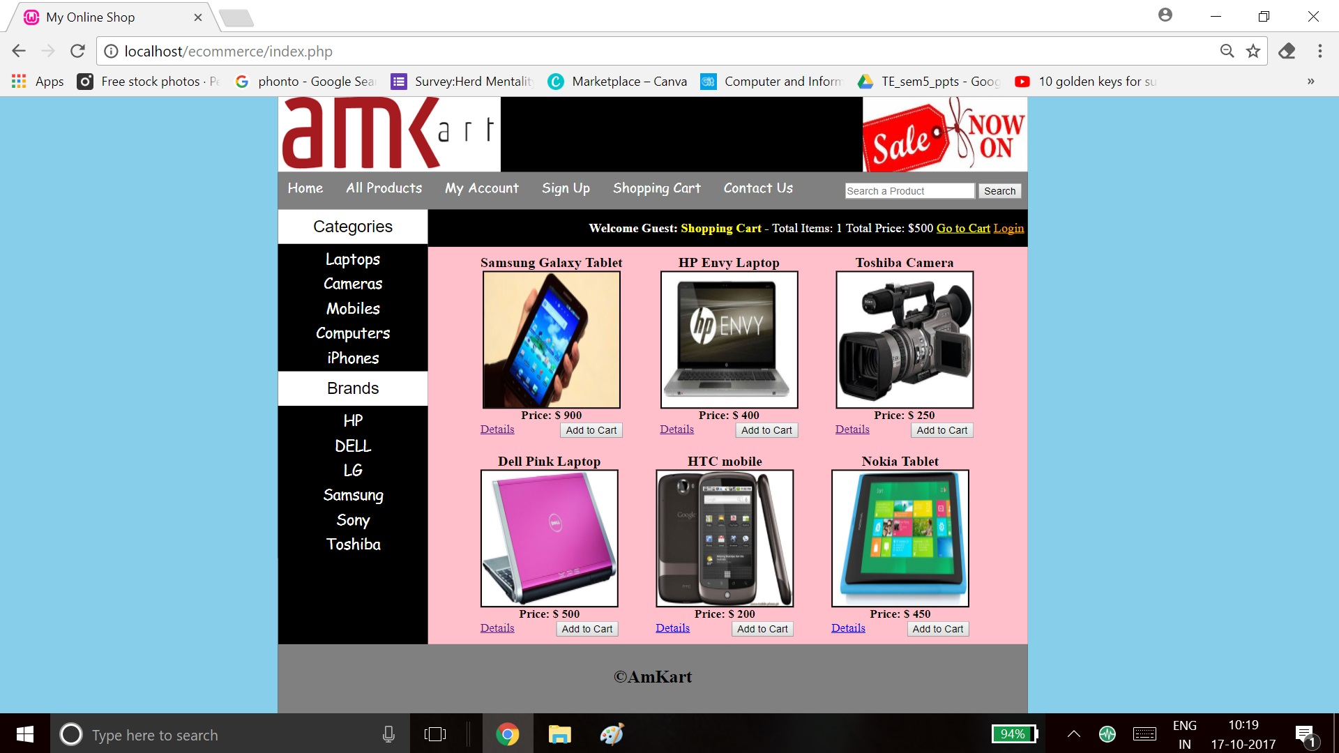
Prototype:
Home page

Slide 7
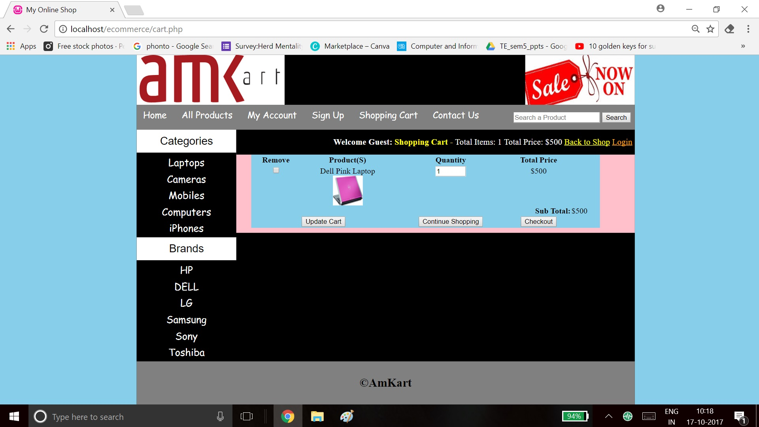
Prototype:
Cart

Slide 8
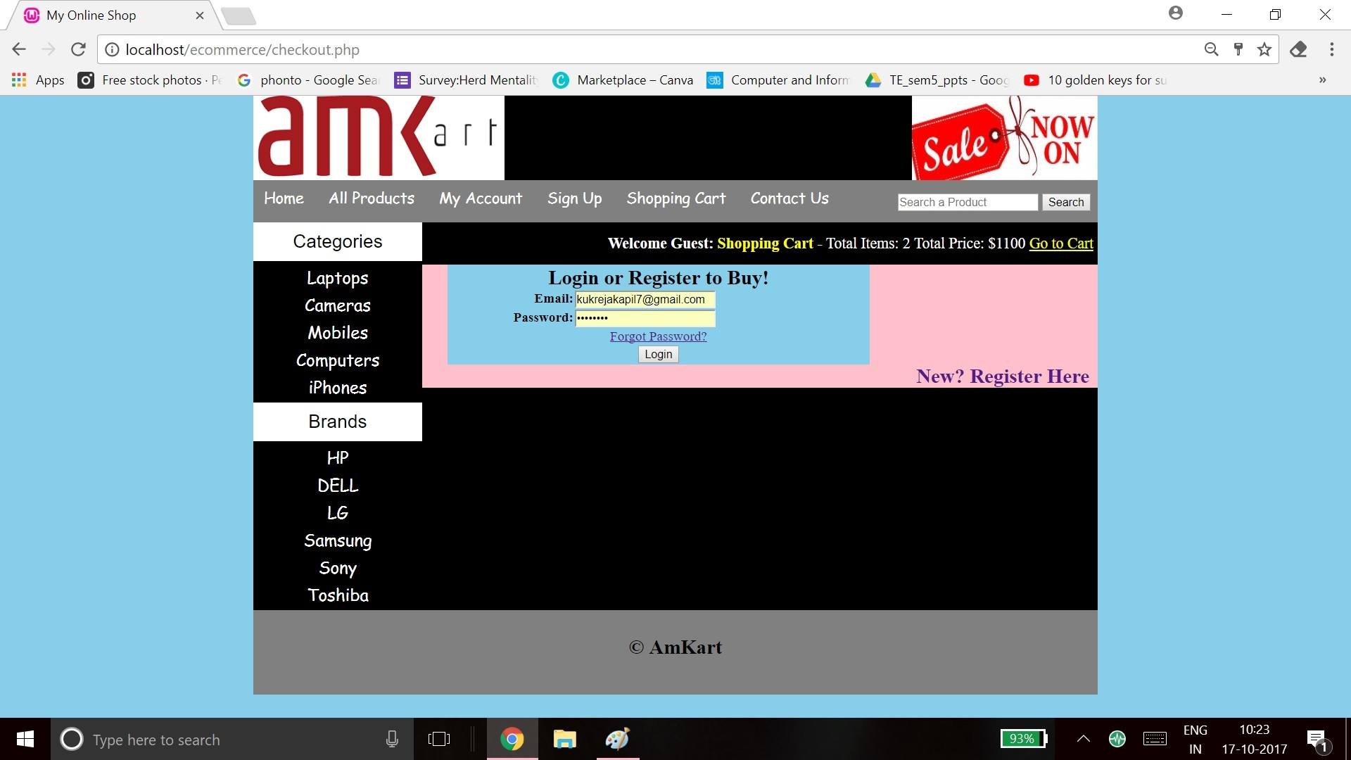
Prototype:
My account

Slide 9
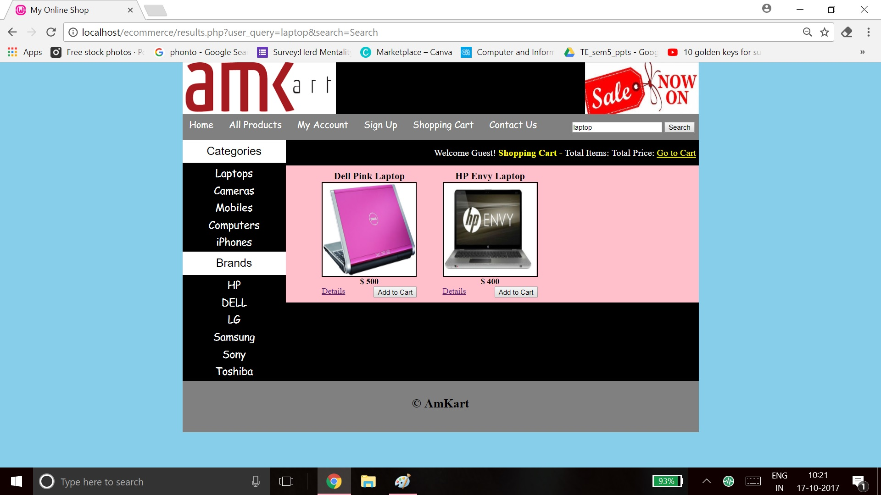
Prototype:
Search

Slide 10

Prototype:
Checkout

Slide 11
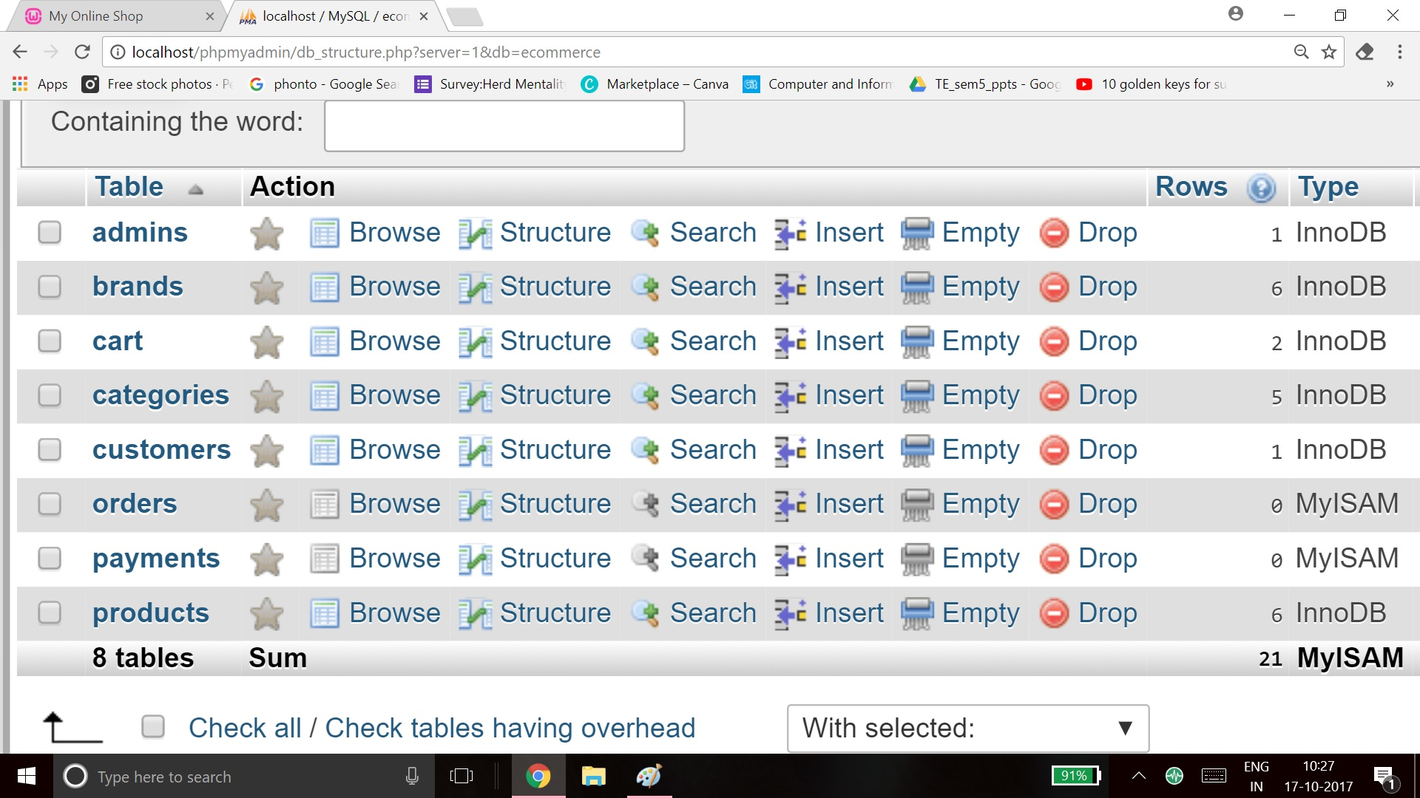
Prototype:
Database

